Slide 1

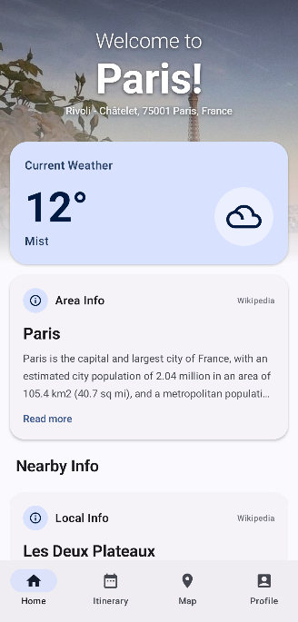

Wanderly
A Location-Aware Travel App
("Plan less, explore more")
Aidan Xu & Shrey Devkar
CS501 E1
5/5/26

Slide 2
Problem statement
Planning a day in a new place is a mess.
Planning a single day in a new city means jumping between Maps, weather apps, review sites, and Wikipedia — then trying to stitch it all into a schedule that actually fits the day. Most people give up halfway and end up wandering aimlessly, eating mediocre food, or missing the best spots right around the corner.

Slide 3
Introducing, Wanderly!
Locates you — live GPS-aware recommendations
Surfaces what's worth your time — ratings, photos, weather, and the story behind each place
Plans the whole day — interest-based itinerary with meals, activities, costs, and timings
Gets you there — routes drawn on the in-app map, one-tap handoff to Google Maps
Searches by name or category — find a specific spot or a whole vibe

Slide 4
Demo

Slide 5
End

